Slide 1
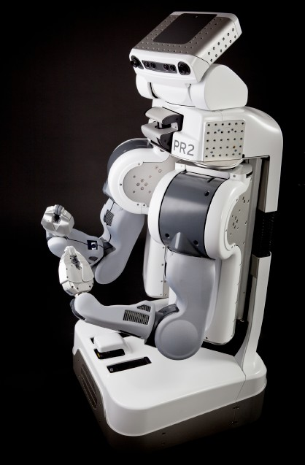
Announcements
Project 5 Ghostbusters
Due Friday 4/15 at 5pm
Homework 9
Released soon, due Monday 4/18 at 11:59pm
Cal Day – Robot Learning Lab Open House
Saturday 10am-1pm
3rd floor Sutardja Dai Hall
Robot demos of knot tying, high-fives, fist-pumps, hugs

Slide 2
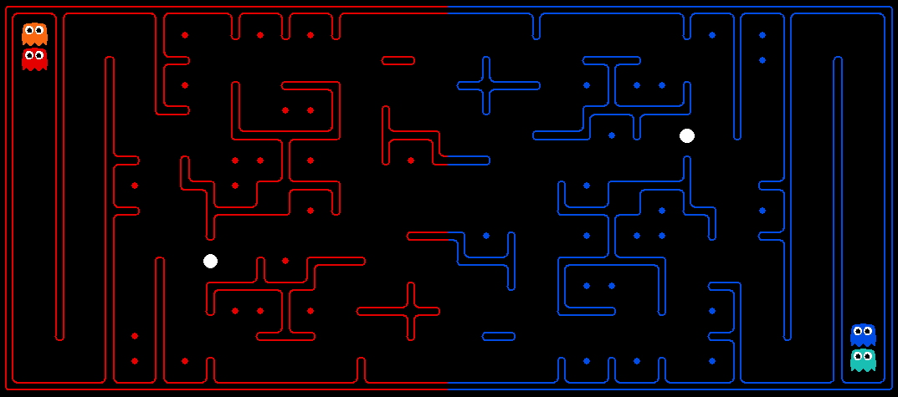
Final Contest!
Challenges: Long term strategy, multiple agents, adversarial utilities, uncertainty about other agents’ positions, plans, etc.

Slide 3
Final Contest Extra Credit
Extra Credit Based on Final Ranking (deadline 4/24 11:59pm)
1st place: 2 points on the final
2nd and 3rd place: 1.5 points on the final
4th to 10th place: 1 point on the final
0.25 points on the final per staff bot beaten in the final ranking.
In addition, every night from 4/17 through 4/24 at 11:59pm we will temporarily close submissions to compute an intermediate ranking, and there is also extra credit:
Top 20: 0.5 points on the final
Top 10: 1 point on the final
Note that the ranking rewards are not cumulative, you will only get points for the highest ranking category you achieve during the contest.

Slide 4
Announcements
Piazza: Don’t discuss exam!
People still taking exam Friday morning.
Project 6: Out next Thursday.

Slide 5
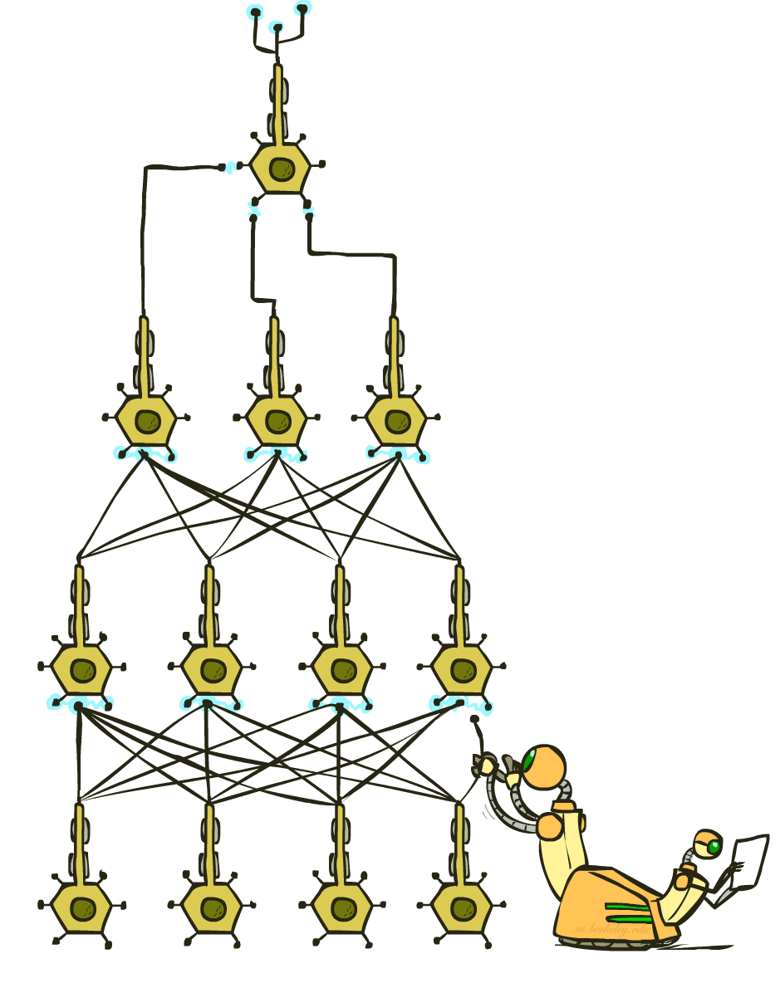
CS 188: Artificial Intelligence
Deep Learning
Instructors: Adam Janin & Josh Hug --- University of California, Berkeley
[These slides created by Dan Klein, Pieter Abbeel, Anca Dragan, Josh Hug for CS188 Intro to AI at UC Berkeley. All CS188 materials available at http://ai.berkeley.edu.]
Notes:
Please retain proper attribution, including the reference to ai.berkeley.edu. Thanks!

Slide 6
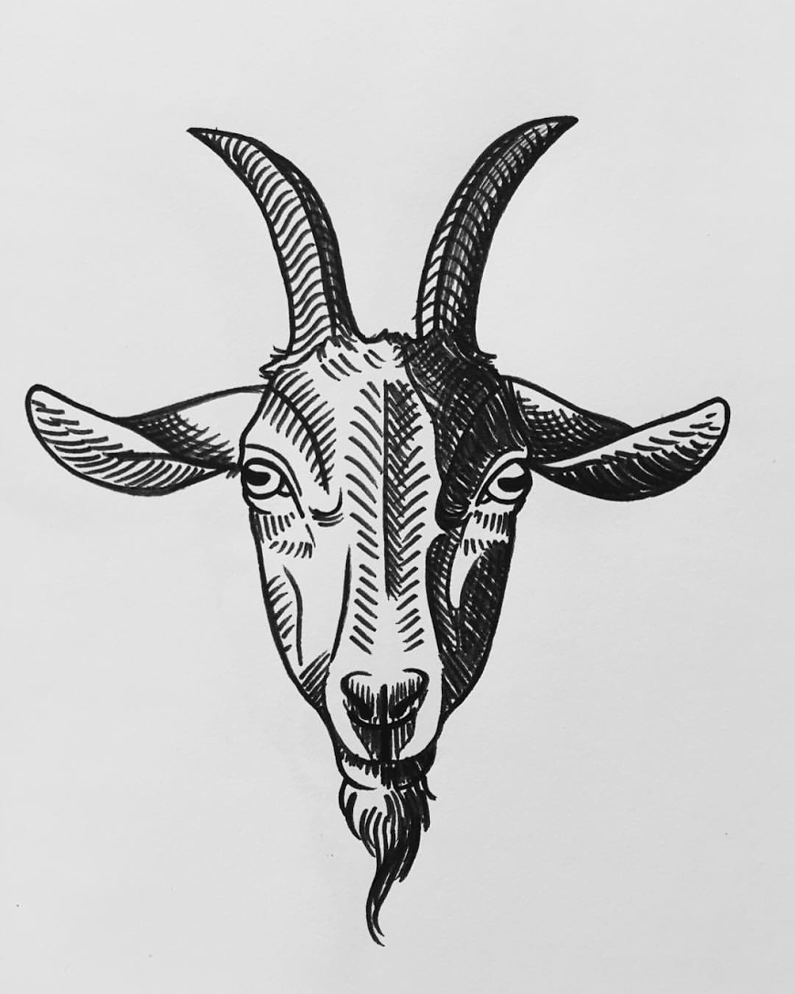
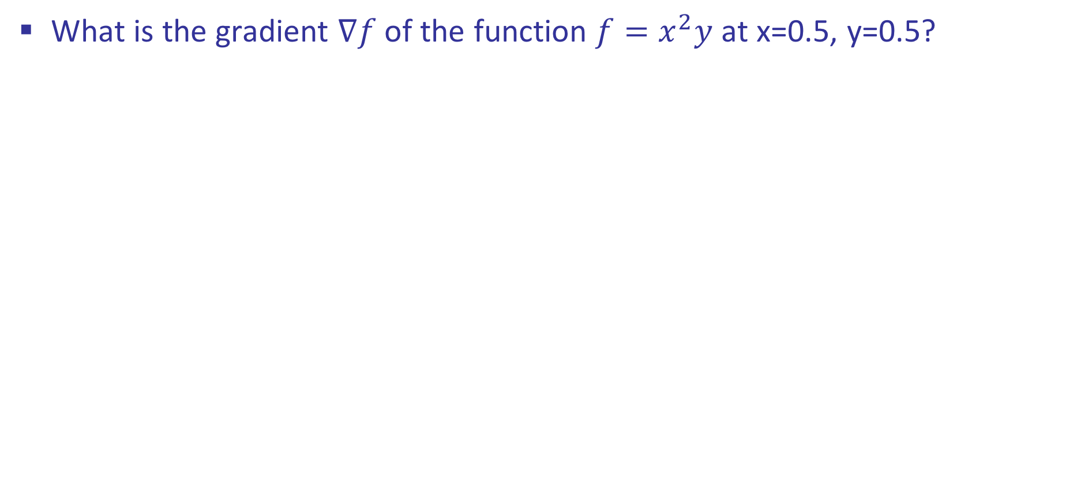
Review: Gradient
What is the gradient $∇f$ of the function ${f=x}^{2}y$ at x=0.5, y=0.5?

Slide 7
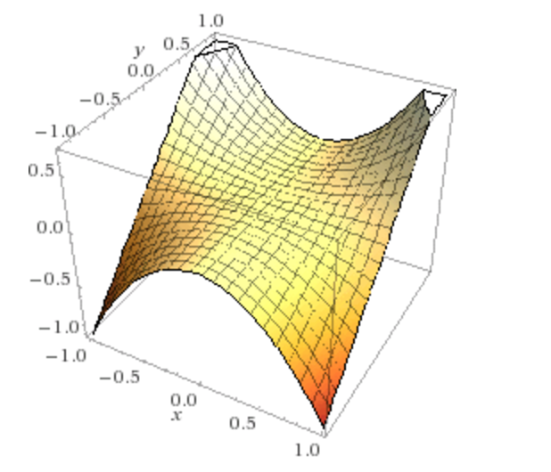
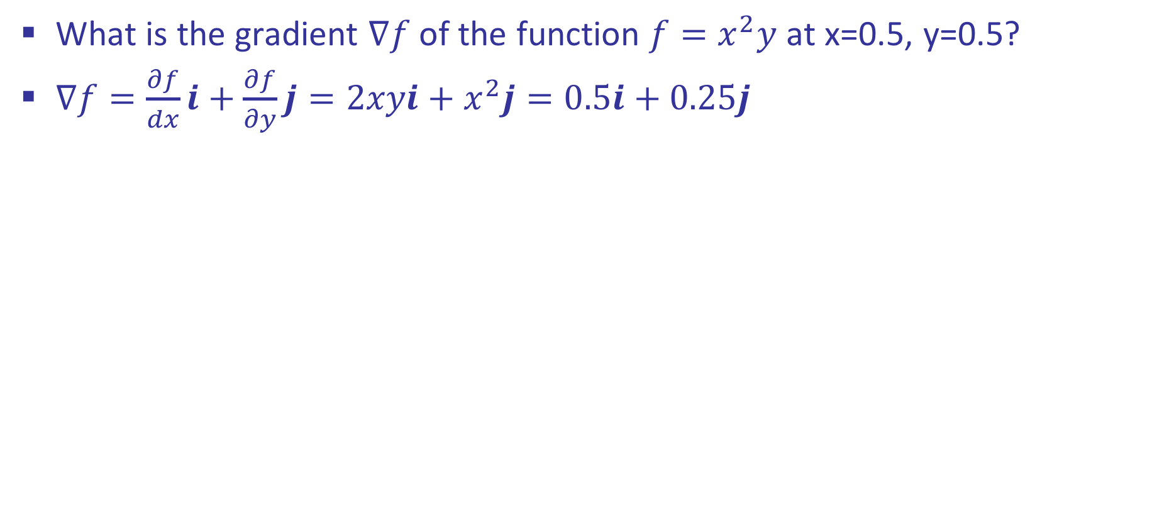
Last Time: Linear Classifiers
What is the gradient $∇f$ of the function $f=x^{2}y$ at x=0.5, y=0.5?
$∇f=\frac{∂f}{dx}i+\frac{∂f}{∂y}j=2xyi+x^{2}j=0.5i+0.25j$
Slope of the graph in both directions.

Slide 8
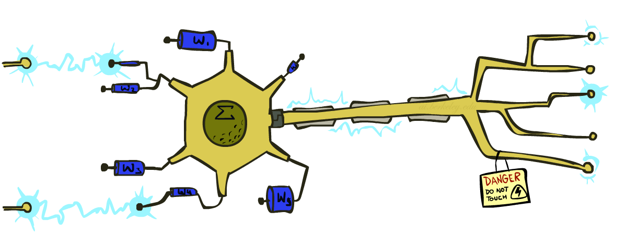
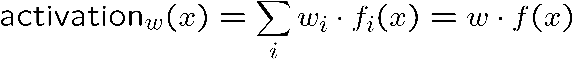
Last Time: Linear Classifiers
Inputs are feature values
Each feature has a weight
Sum is the activation
If the activation is:
Positive, output +1
Negative, output -1
w₁
f₁
Σ
w₂
>0?
f₂
w₃
f₃

Slide 9
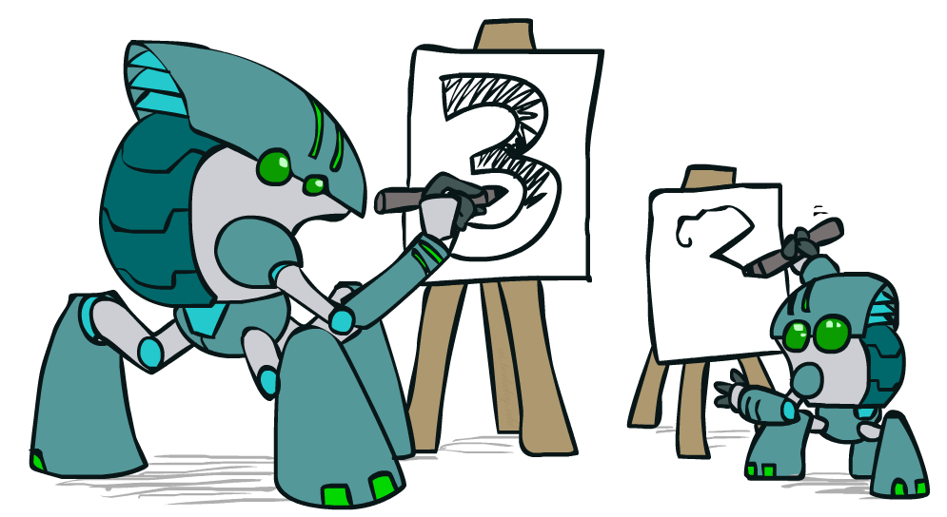
Apprenticeship

Slide 10
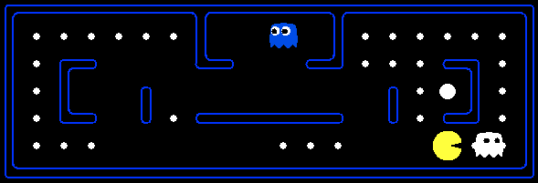
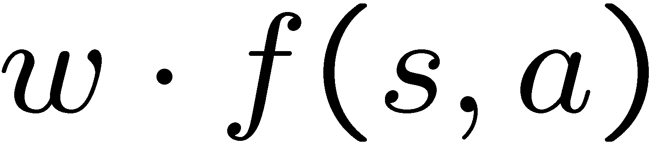
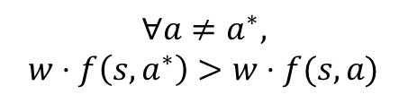
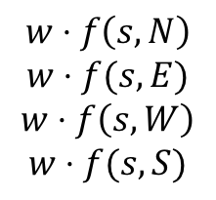
Pacman Apprenticeship!
Examples are states s
Candidates are pairs (s,a)
“Correct” actions: those taken by expert
Features defined over (s,a) pairs: f(s,a)
f(s, a) = {closeToFood, closeToScaredGhost, score, …}
Score of a q-state (s,a) given by:
How is this VERY different from reinforcement learning?
“correct” action a*
$$∀a≠a^{∗},$$
$$w⋅f\left(s, a^{∗}\right)>w⋅f(s,a)$$
$$w⋅f\left(s, N\right)$$
$$w⋅f(s, E)$$
$$w⋅f\left(s, W\right)$$
$$w⋅f(s, S)$$
Pick largest of:
[Demo: Pacman Apprentice (L22D1,2,3)]

Slide 11

Video of Demo Pacman Apprentice

Slide 12
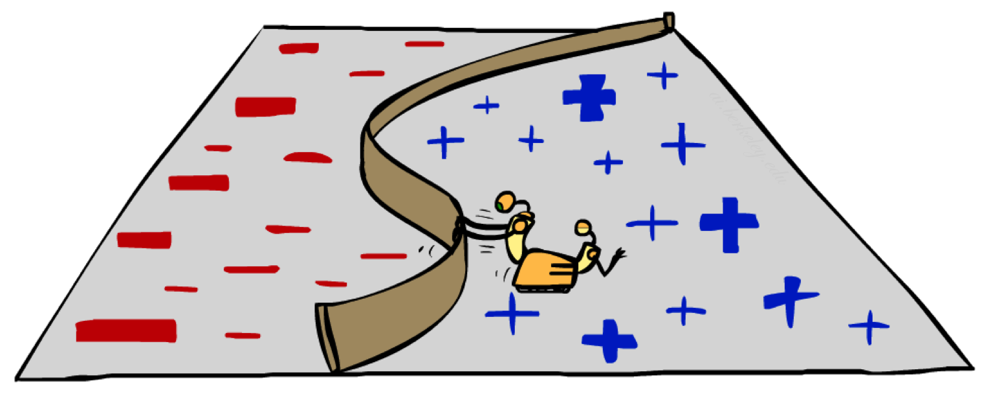
Non-Linearity

Slide 13
Non-Linear Separators
Data that is linearly separable works out great for linear decision rules:
But what are we going to do if the dataset is just too hard?
How about… mapping data to a higher-dimensional space:
0
x
0
x
x²
0
x
This and next slide adapted from Ray Mooney, UT

Slide 14
Non-Linear Separators
General idea: the original feature space can always be mapped to some higher-dimensional feature space where the training set is separable:
Φ: x → φ(x)

Slide 15
Feature Selection
To choose between two feature sets:
For feature set 1: train perceptron on training data -> Classifier 1
For feature set 2: train perceptron on training data -> Classifier 2
Evaluate performance of Classifier 1 and Classifier 2 on hold-out data
Select the one performing best on the hold-out data

Slide 16

Computer Vision

Slide 17
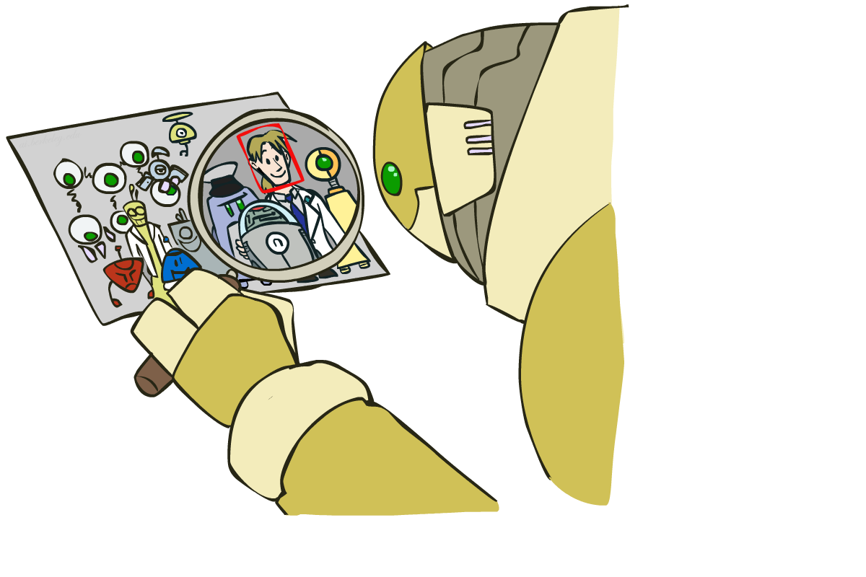
Object Detection

Slide 18

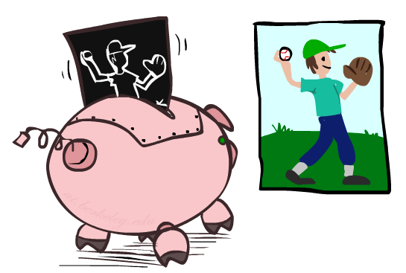

Manual Feature Design

Slide 19
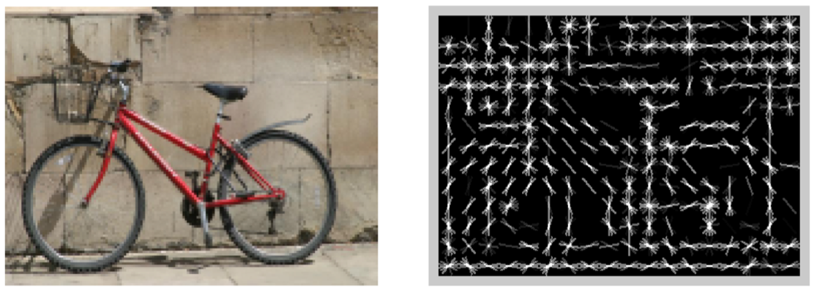
Features and Generalization
[Dalal and Triggs, 2005]

Slide 20
Features and Generalization
Image
HoG
Notes:
HoG, SIFT, Daisy
Deformable part models

Slide 21
Training
Round 1
Training set =
Positive examples: from labeling
Negative examples: random patches
preliminary SVM
Round 2 (“bootstrapping” or “mining hard negatives”)
Training set =
Positive examples: from labeling
Negative examples: patches that have score >= -1
→ final SVM

Slide 22
Manual Feature Design → Deep Learning
Manual feature design requires:
Domain-specific expertise
Domain-specific effort
What if we could learn the features, too?
-> Deep Learning

Slide 23
Perceptron
w₁
f₁
Σ
w₂
>0?
f₂
w₃
f₃

Slide 24
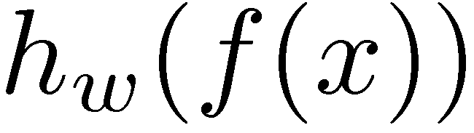
Two-Layer Perceptron Network
w₁₁
Σ
>0?
w₂₁
w₃₁
w₁
f₁
w₁₂
Σ
Σ
w₂₂
>0?
w₂
f₂
>0?
w₃₂
w₃
f₃
w₁₃
Σ
w₂₃
>0?
w₃₃

Slide 25
N-Layer Perceptron Network
Σ
Σ
Σ
>0?
>0?
>0?
…
f₁
Σ
Σ
Σ
Σ
>0?
>0?
>0?
>0?
f₂
…
f₃
Σ
Σ
Σ
>0?
>0?
…
>0?

Slide 26
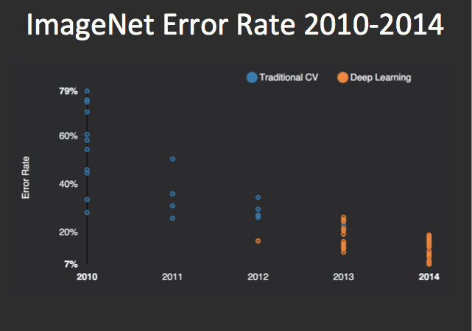
Performance
graph credit Matt Zeiler, Clarifai
Notes:
1,000,000 images in 1,000 categories

Slide 27
Performance
graph credit Matt Zeiler, Clarifai

Slide 28
Performance
AlexNet
graph credit Matt Zeiler, Clarifai

Slide 29
Performance
AlexNet
graph credit Matt Zeiler, Clarifai

Slide 30
Performance
AlexNet
graph credit Matt Zeiler, Clarifai

Slide 31
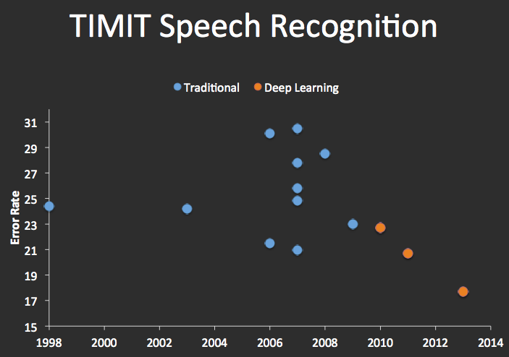


Speech Recognition
graph credit Matt Zeiler, Clarifai

Slide 32
Speech Synthesis: WaveNet
WaveNet (2016)
Approach for the “Text to Speech” problem (TTS).
Concatenative TTS: Short recorded speech fragments concatenated.
Parametric TTS: High level model based speech generation (from scratch).
WaveNet: “Dumb” neural network based model for generating human speech at the level of individual audio samples.
(Note: This is not a classifier! Not a direct application of today’s ideas, but instead an example of the generality of deep neural networks)
https://deepmind.com/blog/wavenet-generative-model-raw-audio/

Slide 33
Insert AI in the news here

Slide 34

How Many Computers to Identify a Cat?
“Google Brain”
[Le, Ng, Dean, et al, 2012]

Slide 35
N-Layer Perceptron Network
Σ
Σ
Σ
>0?
>0?
>0?
…
f₁
Σ
Σ
Σ
Σ
>0?
>0?
>0?
>0?
f₂
…
f₃
Σ
Σ
Σ
>0?
>0?
…
>0?

Slide 36
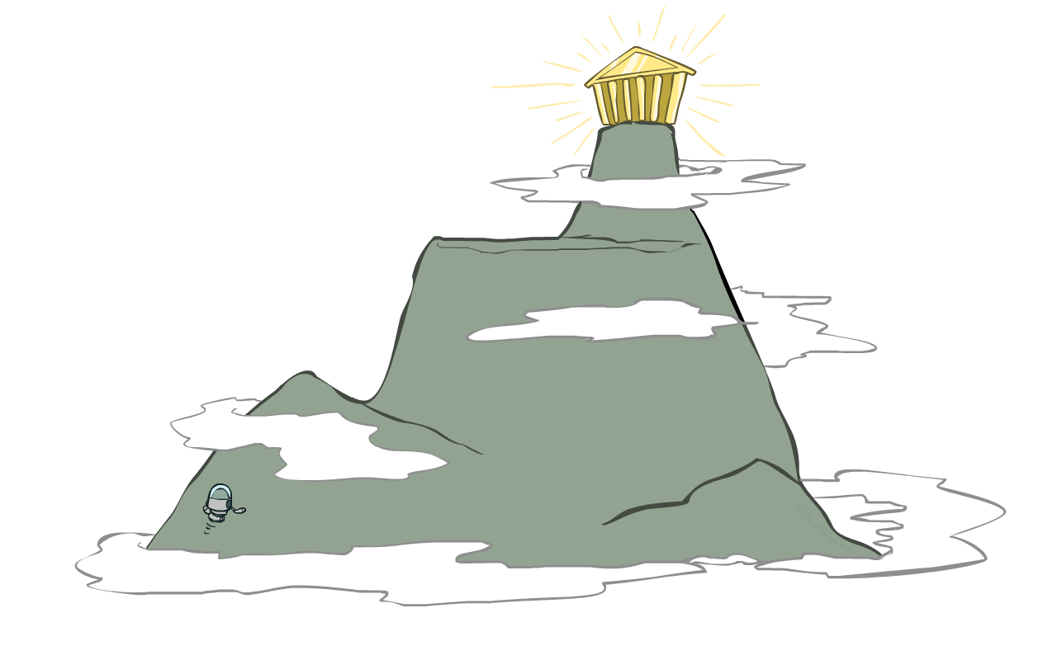
Local Search
Simple, general idea:
Start wherever
Repeat: move to the best neighboring state
If no neighbors better than current, quit
Neighbors = small perturbations of w
Properties
Plateaus and local optima
How to escape plateaus and find a good local optimum?
How to deal with very large parameter vectors? E.g.,

Slide 37
Perceptron: Accuracy via Zero-One Loss
w₁
f₁
Σ
w₂
>0?
f₂
w₃
f₃
Objective: Classification Accuracy
Note: $w^{T}f\left(x\right)=w⋅f(x)$, both notations are common.

Slide 38
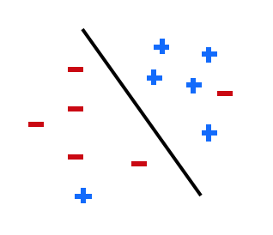
Perceptron: Accuracy via Zero-One Loss
Objective: Classification Accuracy
For the weights, data, and correct labels below, what is l^{acc}?

Slide 39
Perceptron: Accuracy via Zero-One Loss
w₁
f₁
Σ
w₂
>0?
f₂
w₃
f₃
Objective: Classification Accuracy
Issue: many plateaus → how to measure incremental progress?

Slide 40
Soft-Max
Score for y=1: Score for y=-1:
Probability of label:

Slide 41
Soft-Max
Score for y=1: Score for y=-1:
Probability of label:
Suppose w = [-3, 4, 2] and x = [1, 1, 0]
What label will be selected if we score as usual?
What are the probabilities of the possible label assignments if we score using this new approach?

Slide 42
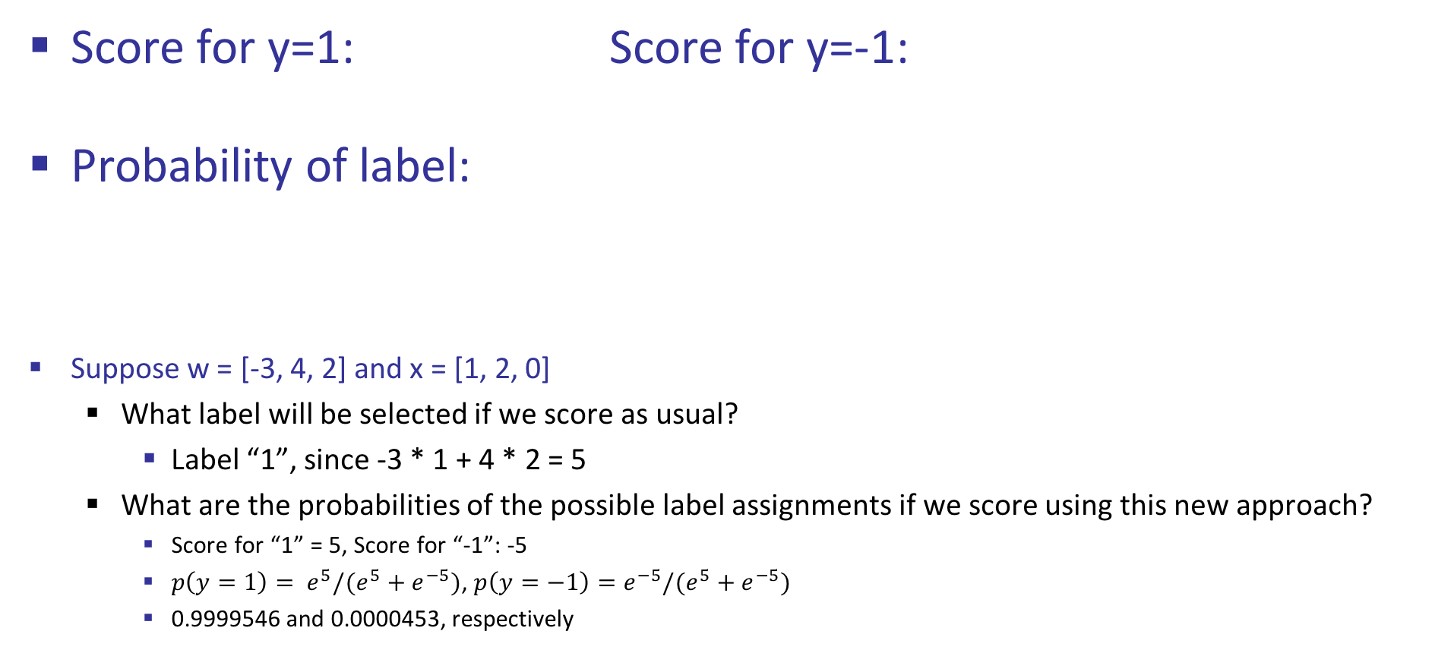
Soft-Max
Score for y=1: Score for y=-1:
Probability of label:
Suppose w = [-3, 4, 2] and x = [1, 2, 0]
What label will be selected if we score as usual?
Label “1”, since -3 * 1 + 4 * 2 = 5
What are the probabilities of the possible label assignments if we score using this new approach?
Score for “1” = 5, Score for “-1”: -5
$p\left(y=1\right)= e^{5}/(e^{5}+e^{−5})$, $p\left(y=−1\right)=e^{−5}/(e^{5}+e^{−5})$
0.9999546 and 0.0000453, respectively

Slide 43
Soft-Max
Score for y=1: Score for y=-1:
Probability of label:
Objective:
Log:

Slide 44
Two-Layer Neural Network
w₁₁
Σ
w₂₁
>0?
w₃₁
w₁
f₁
w₁₂
Σ
Σ
w₂₂
>0?
w₂
f₂
w₃₂
w₃
f₃
w₁₃
Σ
w₂₃
>0?
w₃₃

Slide 45
N-Layer Neural Network
Σ
Σ
Σ
>0?
>0?
>0?
…
f₁
Σ
Σ
Σ
Σ
>0?
>0?
>0?
f₂
…
f₃
Σ
Σ
Σ
>0?
>0?
…
>0?

Slide 46
Our Status
Our objective
Changes smoothly with changes in w
Doesn’t suffer from the same plateaus as the perceptron network
Challenge: how to find a good w ?
Equivalently:

Slide 47
1-d optimization
Could evaluate and
Then step in best direction
Or, evaluate derivative:
Which tells which direction to step into

Slide 48
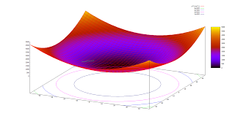
2-D Optimization
Source: Thomas Jungblut’s Blog

Slide 49
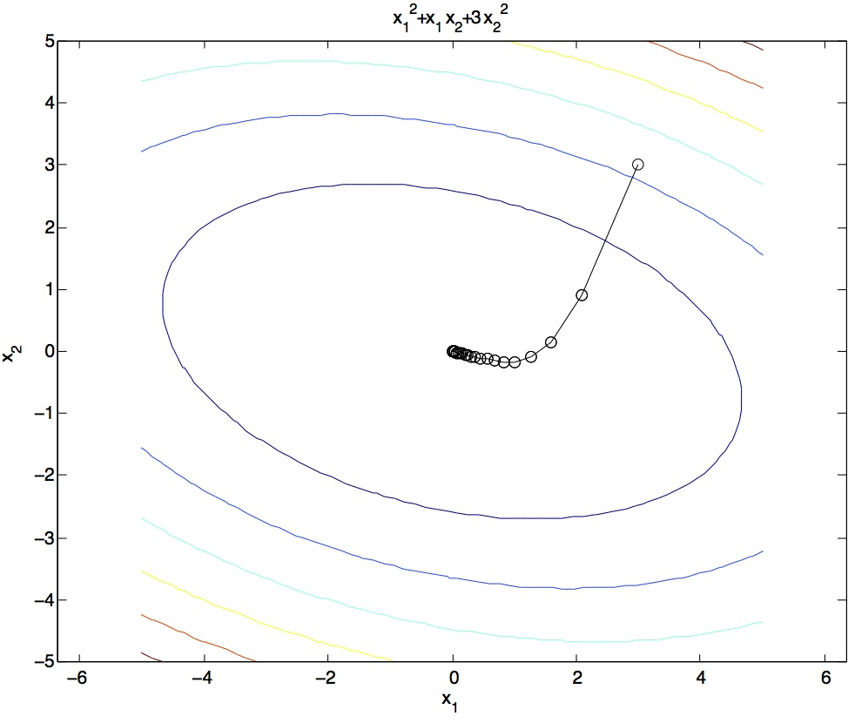
Steepest Descent
Idea:
Start somewhere
Repeat: Take a step in the steepest descent direction
Figure source: Mathworks

Slide 50
What is the Steepest Descent Direction?
First-Order Taylor Expansion:
Steepest Descent Direction:
Recall: →
Hence, solution:

Slide 51
Generally, Steepest Direction
Steepest Direction = direction of the gradient

Slide 52
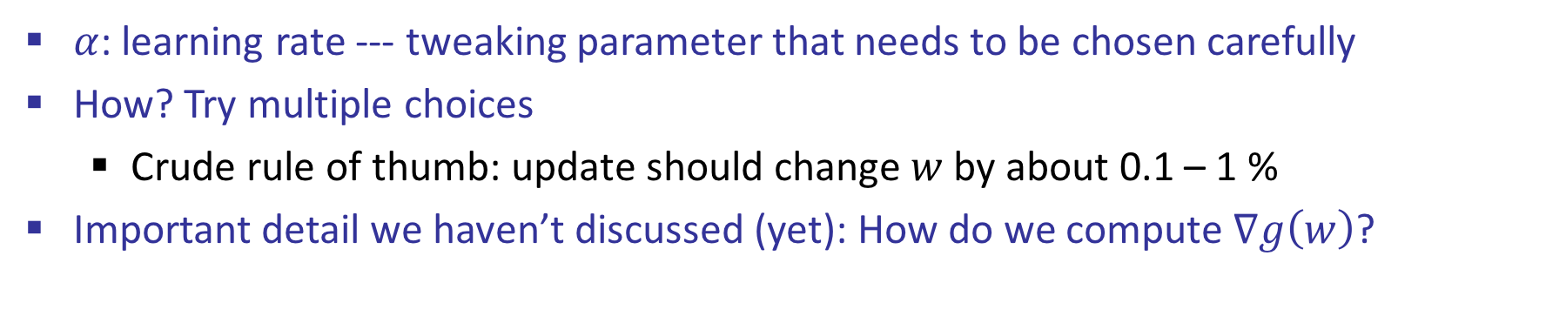
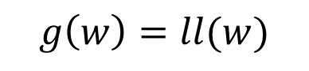
Optimization Procedure 1: Gradient Descent
Init:
For i = 1, 2, …
$$g\left(w\right)=ll(w)$$
$α$: learning rate --- tweaking parameter that needs to be chosen carefully
How? Try multiple choices
Crude rule of thumb: update should change $w$ by about 0.1 – 1 %
Important detail we haven’t discussed (yet): How do we compute $∇g\left(w\right)$?

Slide 53
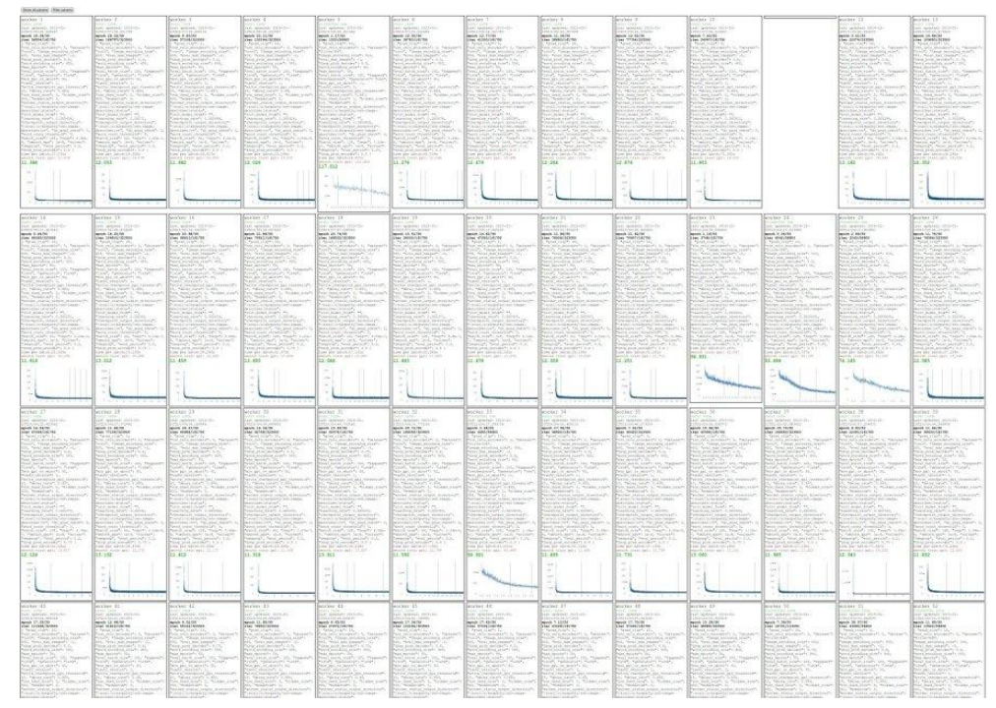
Try Many Learning Rates

Slide 54
Neural Network Playground
Let’s see some Neural Networks in action: (Link)
Note: ”Perceptrons” in this example use tanh activation function, not thresholded to zero or one.

